Slide 1





ICS3U Final Project
by Sandy & Collin

Slide 2


Simple Banking System Web Page （ HTML）
HTML Code Explanation
Let’s see how many computer parts you can name and describe! Ready, set, go!

Slide 3
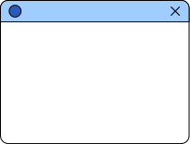



Basic HTML Structure
<!DOCTYPE html>: Declares the document type and version of HTML.
<html>: Root element of the HTML document.
<head>: Contains meta-information like the title and styles.
<body>: Contains the visible content of the webpage.

Slide 4


Title and Styling
<title>: Sets the title of the webpage (displayed in the browser tab).
<style>: Adds internal CSS for styling.
body: Sets the background color and font.
table, th, td: Styles the table with borders and padding.

Slide 5


Header and Introduction
<h1>: Main heading for the webpage.
<p>: Paragraph introducing the banking system.
<img>: Displays an image related to banking.

Slide 6
Account Overview Table
<title>: Sets the title of the webpage (displayed in the browser tab).
<style>: Adds internal CSS for styling.
body: Sets the background color and font.
table, th, td: Styles the table with borders and padding.

Slide 7
User Account Section
<h2>: Subheading for the user account section.
<p>: Explains what users can do (create accounts, check balances, etc.).
<a>: Link to a "Sign Up" page (placeholder).

Slide 8
Admin Section
<h2>: Subheading for the admin section.
<p>: Explains admin capabilities (view accounts, block users, etc.).

Slide 9


Conclusion
The webpage provides a simple interface for a banking system.
It includes sections for account overview, user accounts, and admin functions.
The code uses basic HTML tags and CSS for styling.

Slide 10
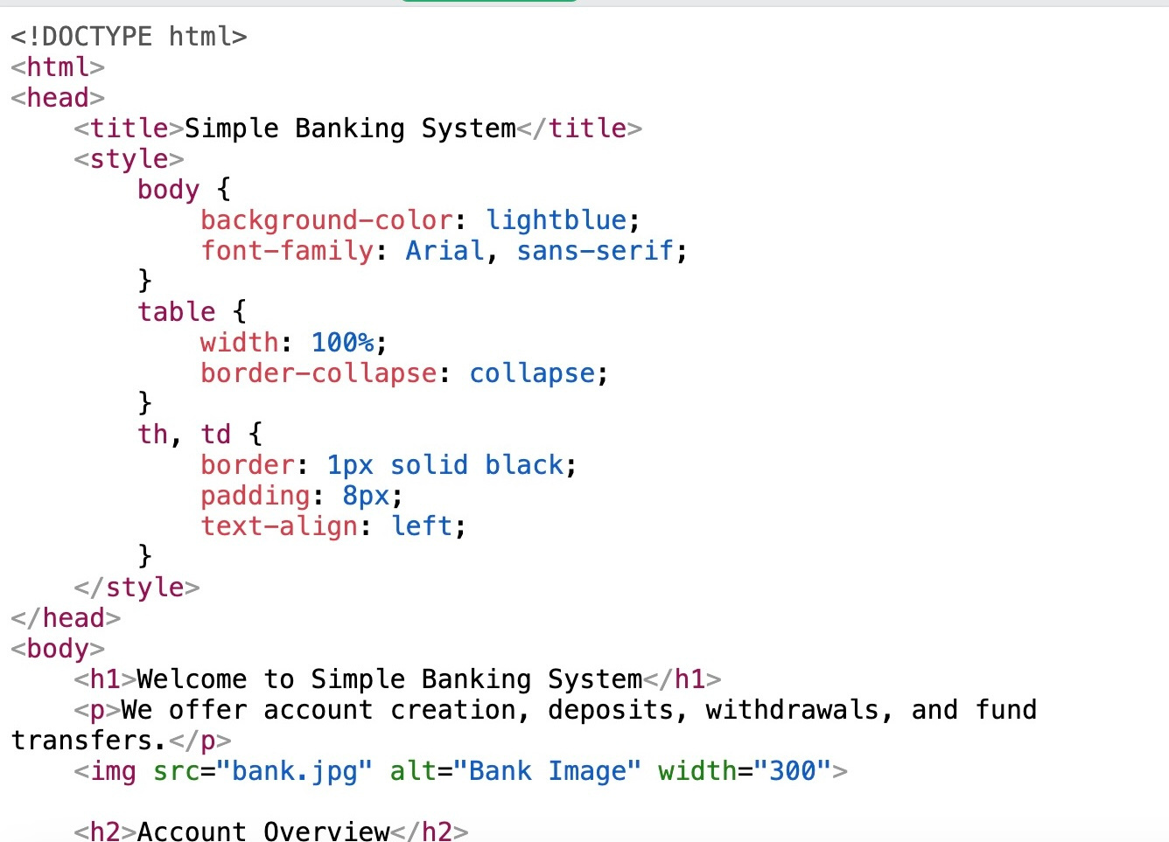

Slide 11
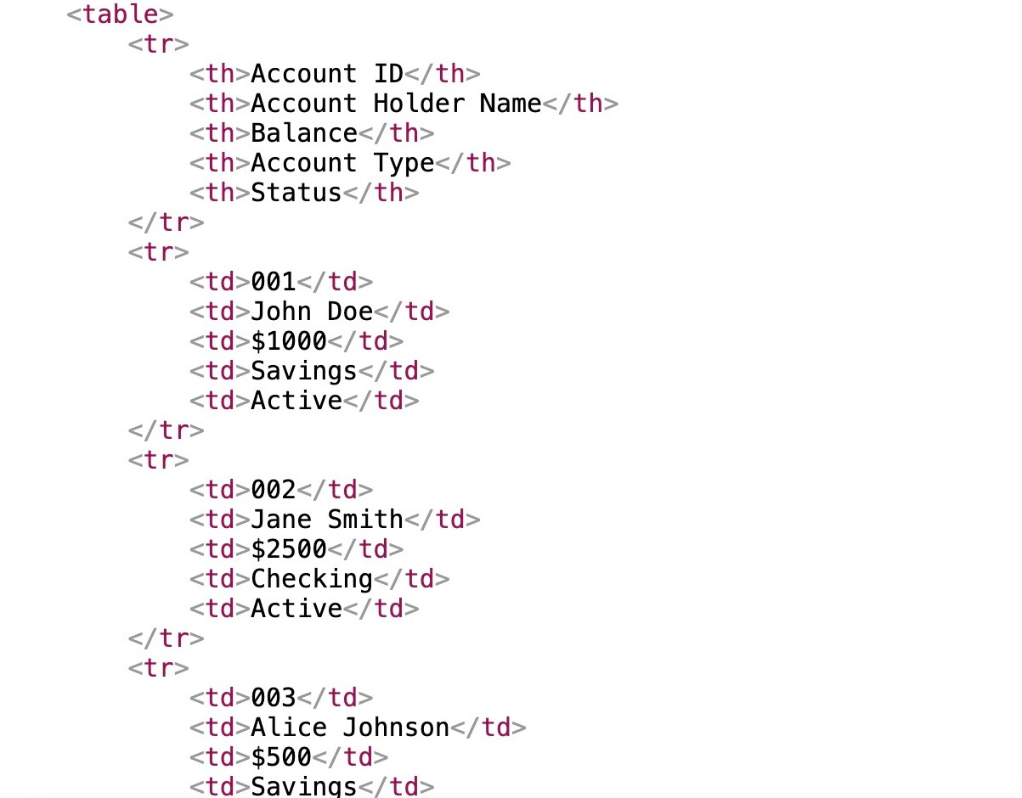

Slide 12
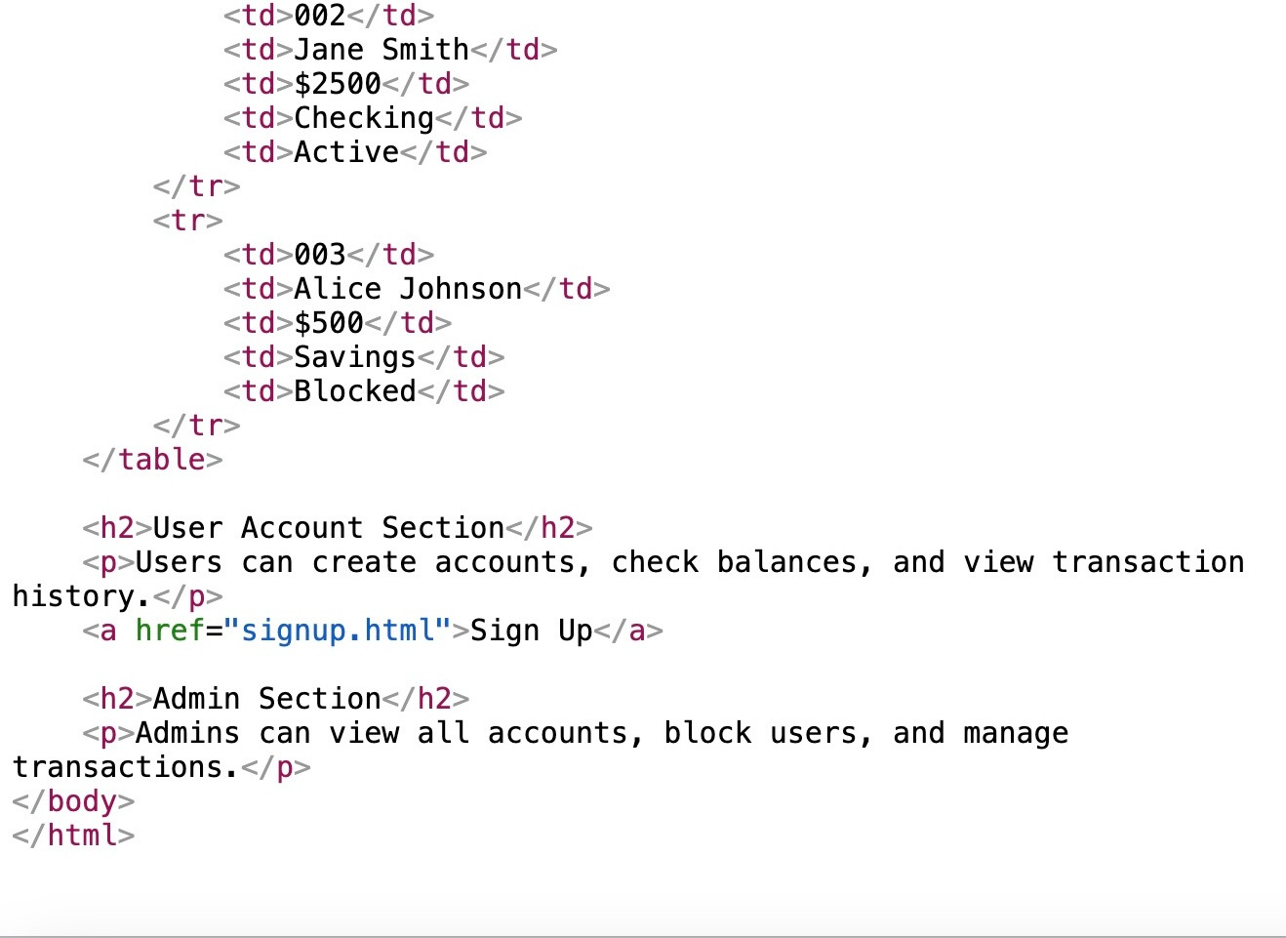

Slide 13



Thank you ！
Bye

